Slide 1
Guidelines for Spotlights Rules How to embed a video in a PowerPoint Presentation
14-4-2015
1
Notes:
14/04/2015
1

Slide 2
Basic Rules
Maximum 1 Spotlight per Company
Duration = maximum 7 minutes
The spotlight to be presented by someone representing the company
Presentation should be a PowerPoint file running with Windows – please use PowerPoint 2007 or 2008 (PowerPoint 2003 not accepted)
Advertising movies are not allowed
The language is English

Slide 3
Spotlight Content & Procedure
Content:
Must be an innovation showing a direct connection to Corrugated
Must give a clear description of the innovation (product or technique)
Selection by the Production Committee (PC)
Deadlines:
Registration to Spotlight sessions: 26th June 2015
Delivery deadline to FEFCO: 15th September 2015
Production Committee Spotlights review and feedback to companies: 25th September 2015

Slide 4
How and to whom to send your folder?
If your file is smaller than 8 MB, you can send it by email to houriet.lefebvre@fefco.org
Please indicate in the subject line of the Email:
“Spotlight Presentation”
Name of the Presenter (first then last names)
Presentation title as to appear on the printed programme of the seminar

Slide 5
How and to whom to send your folder?
If your file is larger than 8 MB and/or contains videos:
Please send it by post on a CD, DVD or USB-stick to FEFCO Secretariat:
To Houriet Lefebvre
FEFCO AISBL
Avenue Louise 250, 12th floor
1050 Brussels, Belgium

Slide 6
How to prepare a folder and embed a Video?
If you have a video, please follow the procedure described in the next slides to know how to prepare a folder and embed a Video in it …

Slide 7
Prepare Folder and Embed Video
Create a folder with:
The PowerPoint folder should contain:
Embed video
Video should be embedded from this folder
Send Folder to FEFCO
Save the folder on a USB key or a DVD and send it to FEFCO Secretariat
Video(s): .avi ; .mpeg; .wmv; or .mp4 video formats are accepted
Word document explaining which video is linked to which slide
Failure to do so: when copied to another computer the video does not work
How to embed the video? See next slides
Important: sound must be embed into the video!
Example
of Folder

Slide 8
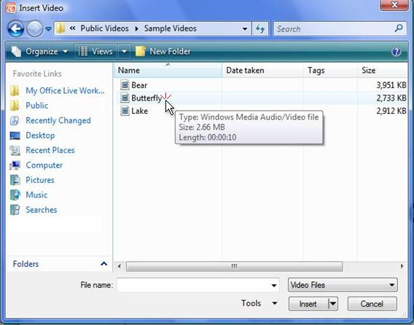
How to embed a video into a PowerPoint?
In Normal view, click the slide in which you want to embed a video.
On the Insert tab, in the Media group, click the arrow under Video, and then click Video from file.
In the Insert Video dialog box, locate and click the video that you want to embed, and then click Insert.
Source :

Slide 9
TIPS
You can also click the Video icon in a content layout to insert a video.

Slide 10
Embed a video (2:20)
and you may remember this: That when you embed an object like a photograph or a video into a PowerPoint presentation,
I have here a simple sales plan presentation that has a need for a video here on slide three.
it increases the presentation’s size. I’d like to show you how that works.
Over here on the File menu we have the Properties section, under which there is the Size,
which is indicating the size of the presentation as it exists now: 451 KB.
Now that’s going to increase once we insert the video into slide three.
I’m going to go ahead and just click the Return to Document icon up here at the top
so that all I have to do is come over here to my Insert Media Clip button and select it.
Once I do that, I’m taken to the Insert Video dialog box, and I can select the video I want.
Now, once I select that video, it gives me a representation of the video, or a preview
with the ability to play that video should I wish to, to verify that it’s the correct one.
We’re going go ahead and just take a quick look at how that works.
Now, if at any time I wish to stop this before it gets to the end of the video,
all I’d need to do is stop it here or click Insert to insert the video.
Now, let’s go see how this has increased its size. To do that we need to go ahead and click the Save button,
then we go to File tab once again, back over here to Properties, down to Size
and we see that we have increased this presentation size by over 20 MB with the insertion of a single video.
So, it’s important that you understand the impact of embedding video in your presentation.
and the first thing I’d like to point out is that we have been brought into the Video Tools menu
under the Format tab where we have a Play button and the ability to adjust our video
and an indicator of where I am in the video and two buttons that move me back
Then I also have here, a time indicator and a button that allows me to increase or decrease the volume
and I don’t need to play the whole thing right now so to stop this playing,
I can either pause it again or I can go ahead and click outside the video
it immediately moves back to its starting point and stops playing.
but because we used a layout, it’s pretty good, so I’m going to leave it alone.
So that’s how we play in Normal view. But notice what happens when I play it in Slide Show view,
I’m going to select our first slide and select the Slide Show button.
Then I can use the Space bar to move through the presentation to the slide I want.
And once we view our video slide, we see that I have to do something special:
I have to hover over the slide so that I get the Play button and then I can click Play, and it plays.
Once this video has finished running all I need to do is hit the Space bar again to move on to the next slide,
at which point we can simply close the presentation and go back to our normal view.
So that’s how to embed and play a video in our PowerPoint presentation.
It’s real straightforward. I’m going to embed the video
So let’s get started and go back over and do that.
and it takes us right back to slide three.
Once we’re here in the slide, I have this slide layout set up
I just click the Play button for a preview.
And it inserts the video directly into our presentation.
It can increase the size.
That being said, this actually works for us,
so we’re going to go ahead and go back over to our slide
and we’re going to take a look at this presentation
and here we have some Video Styles, etc.
And down here I have, on the video itself, a Play button
or move me forward a quarter of a second, in the video.
or completely mute and unmute the video.
So, notice that I can play the video.
We’re just testing it and it plays just fine
and you’ll notice that when I do that,
I could also choose to resize this to be smaller or larger,
as though I were giving a presentation.
Point to the bottom of the video to see the video controls. Drag or point along the progress bar to move forward or go back.
Notes:
[Note to trainer: If you have trouble playing this video, for instance if a Codec Unavailable message appears in the video playback window, the presentation might have opened in Protected View. To enable video playback, in the yellow security bar at the top of the PowerPoint window, click Enable Editing. Note that even with Protected View turned on, video should play correctly in Slide Show view.]

Slide 11
Questions?
Please contact us with your questions at houriet.lefebvre@fefco.org

